Slide 1
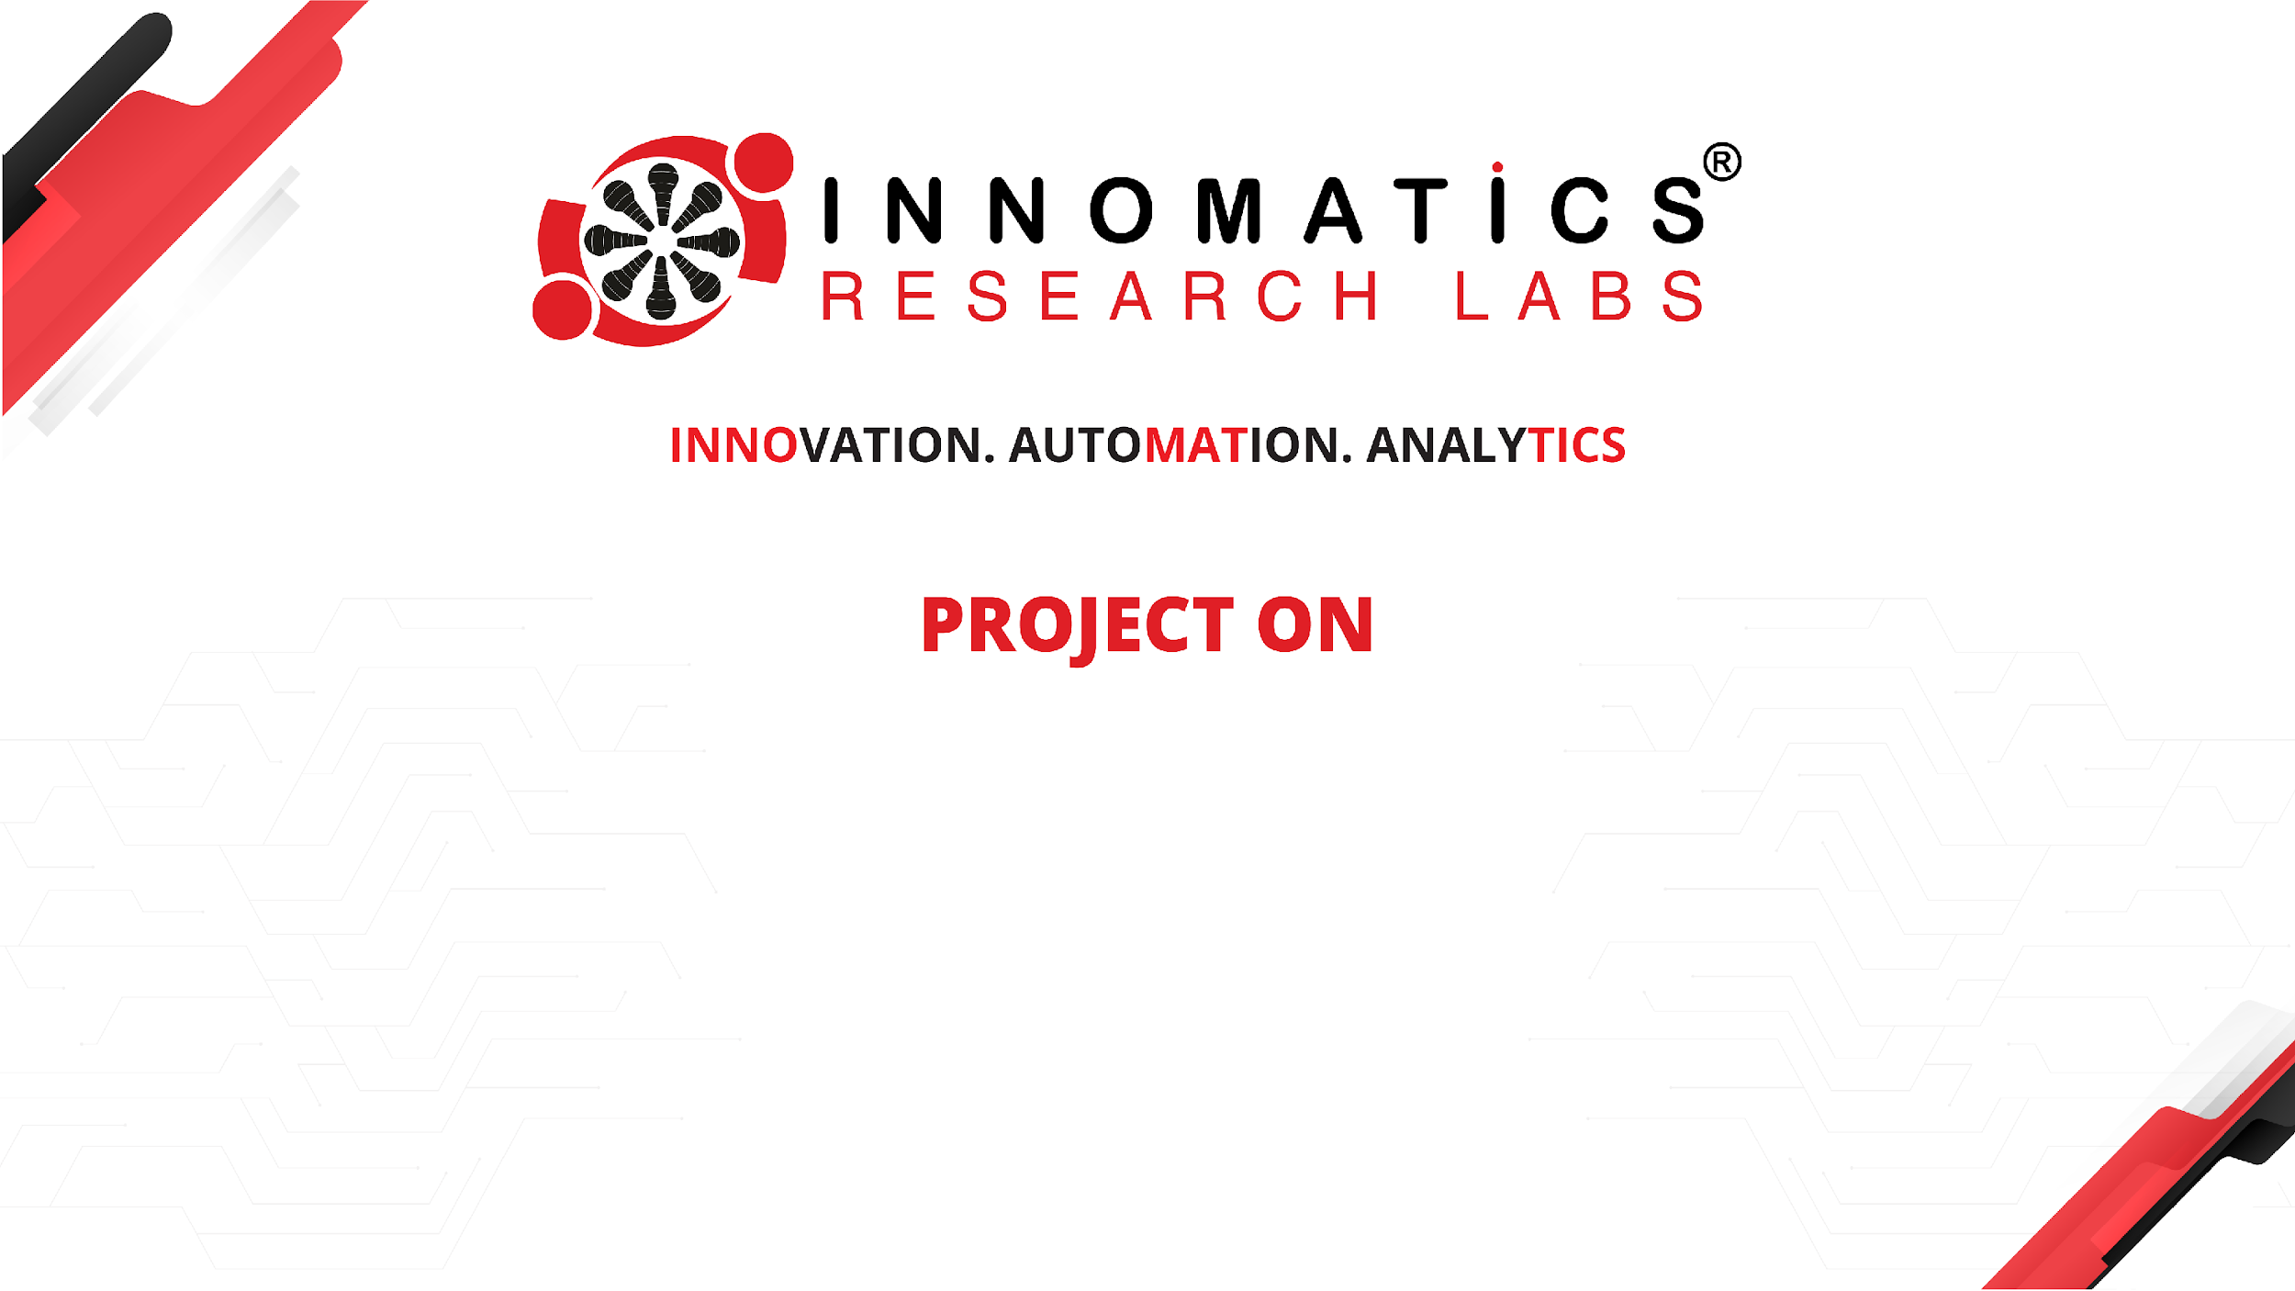
Note Taking App

Slide 2
About me
Hello everyone, I’m Aditya, a passionate and ambitious graduate with a Bachelor's degree in Information Technology. My academic background has provided me with a solid foundation in software development, data science, machine learning, and data analysis.
As a graduate entering the field of data science, machine learning, and data analysis, I am eager to leverage my skills and knowledge to contribute to innovative projects and tackle complex challenges.
In addition to my software development skills, I have a keen interest in data science and analytics. During my academic studies, I delved into various aspects of data analysis, including data visualization, statistical analysis, and machine learning algorithms. I have experience using libraries such as Pandas, NumPy, Matplotlib, and Scikit-learn to extract insights from data and build predictive models.
I am excited about the prospect of applying my skills in software development and data science to real-world projects. Whether it's developing software applications, conducting data analysis, or implementing machine learning solutions, I am eager to make a meaningful impact and contribute to the advancement of technology.
As I embark on this new chapter in my career, I am open to exploring opportunities that will allow me to further develop my skills and gain hands-on experience in software development, data science, and machine learning. I am committed to continuous learning and growth, and I look forward to the challenges and opportunities that lie ahead.

Slide 3
Objective
Efficient Note Capture: Enable users to quickly note down notes using a simple and intuitive interface, minimizing the time and effort required to record their thoughts and ideas.
Seamless Organization: Provide users with the ability to organize their notes effectively, ensuring easy retrieval and reference when needed, thus enhancing their productivity and workflow management.
Real-Time Display: Implement a feature that instantly displays newly added notes in real-time, allowing users to see their notes populate dynamically without the need for manual refreshes.
Persistent Storage: Ensure that all notes are securely stored locally, guaranteeing that they remain accessible even after closing or refreshing the application, thereby preventing data loss and preserving continuity.
User-Friendly Experience: Prioritize usability and user experience by designing a clean and intuitive user interface, facilitating smooth navigation and interaction for users of all skill levels.
Cross-Platform Compatibility: Develop the Note Taking App to be compatible across various devices and platforms, including web browsers and mobile devices, to accommodate users' preferences and usage habits.

Slide 4
Features
User-friendly Interface: The app boasts a clean and intuitive interface, making it easy for users to navigate and utilize its features efficiently.
Dynamic Note Addition: Users can add notes on-the-go with ease, utilizing a simple text input field and a dedicated "Add Note" button.
Real-time Display: As soon as a note is added, it appears instantly in the list below the text field, providing users with immediate feedback and visibility of their entries.
Technologies Used
Flask
Python

Slide 5
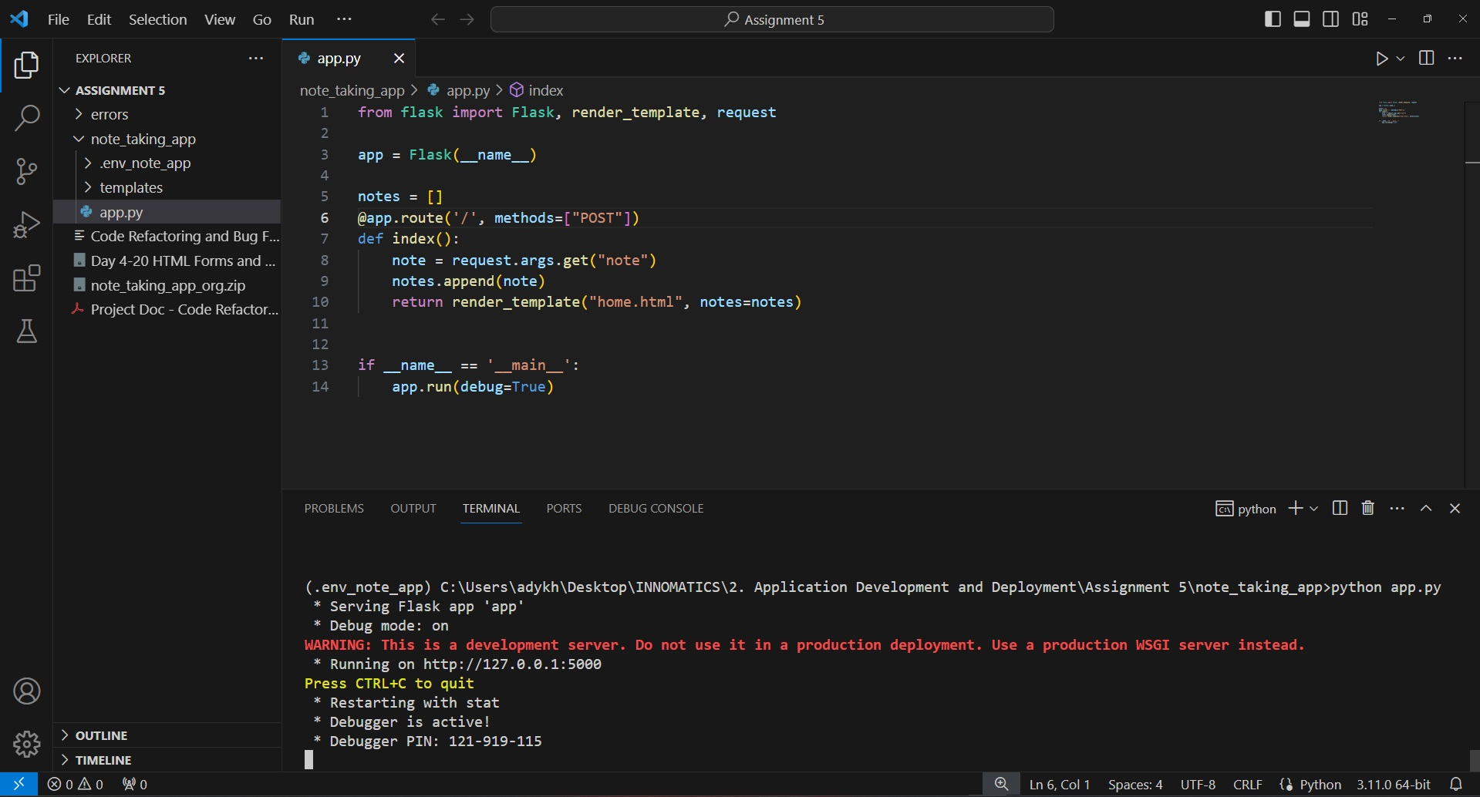
Development
The provided code gives error !!

Slide 6
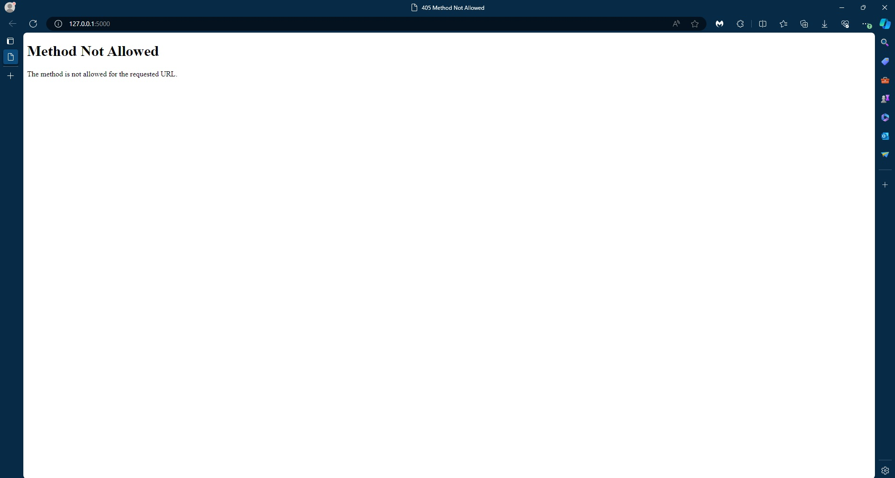
Error !!

Slide 7
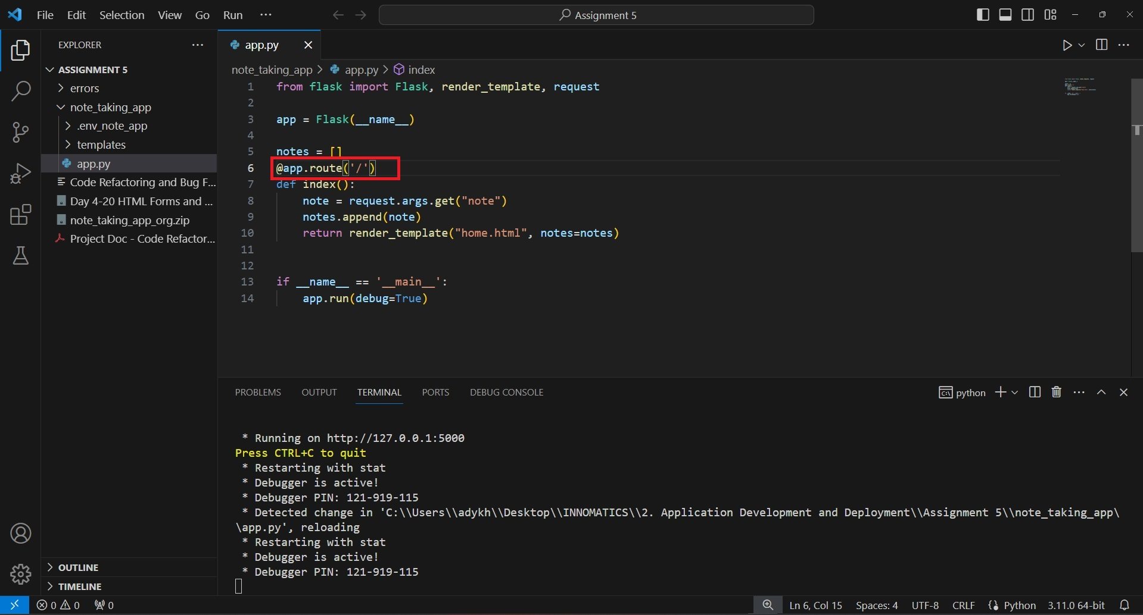
We need to remove the POST method from @app.route, as we are not sending anything !!

Slide 8
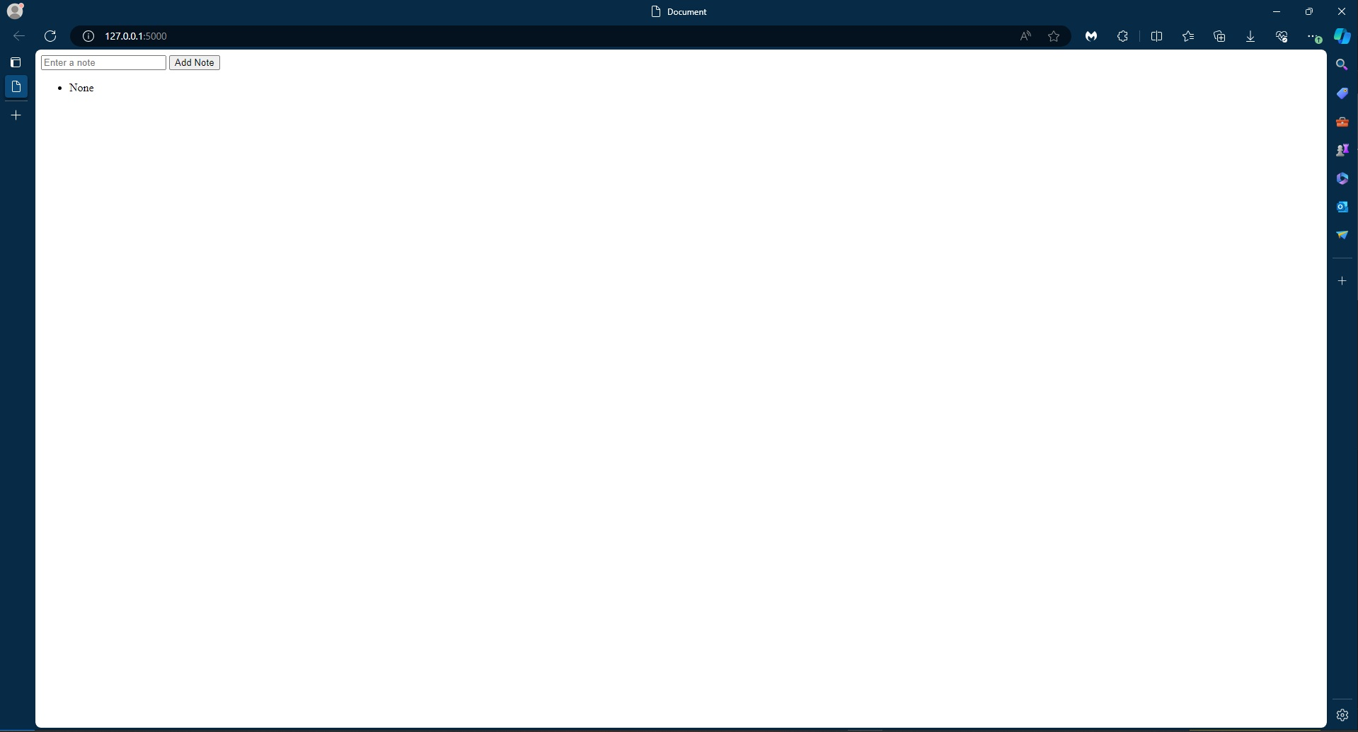
After successfully running for the first time !!

Slide 9
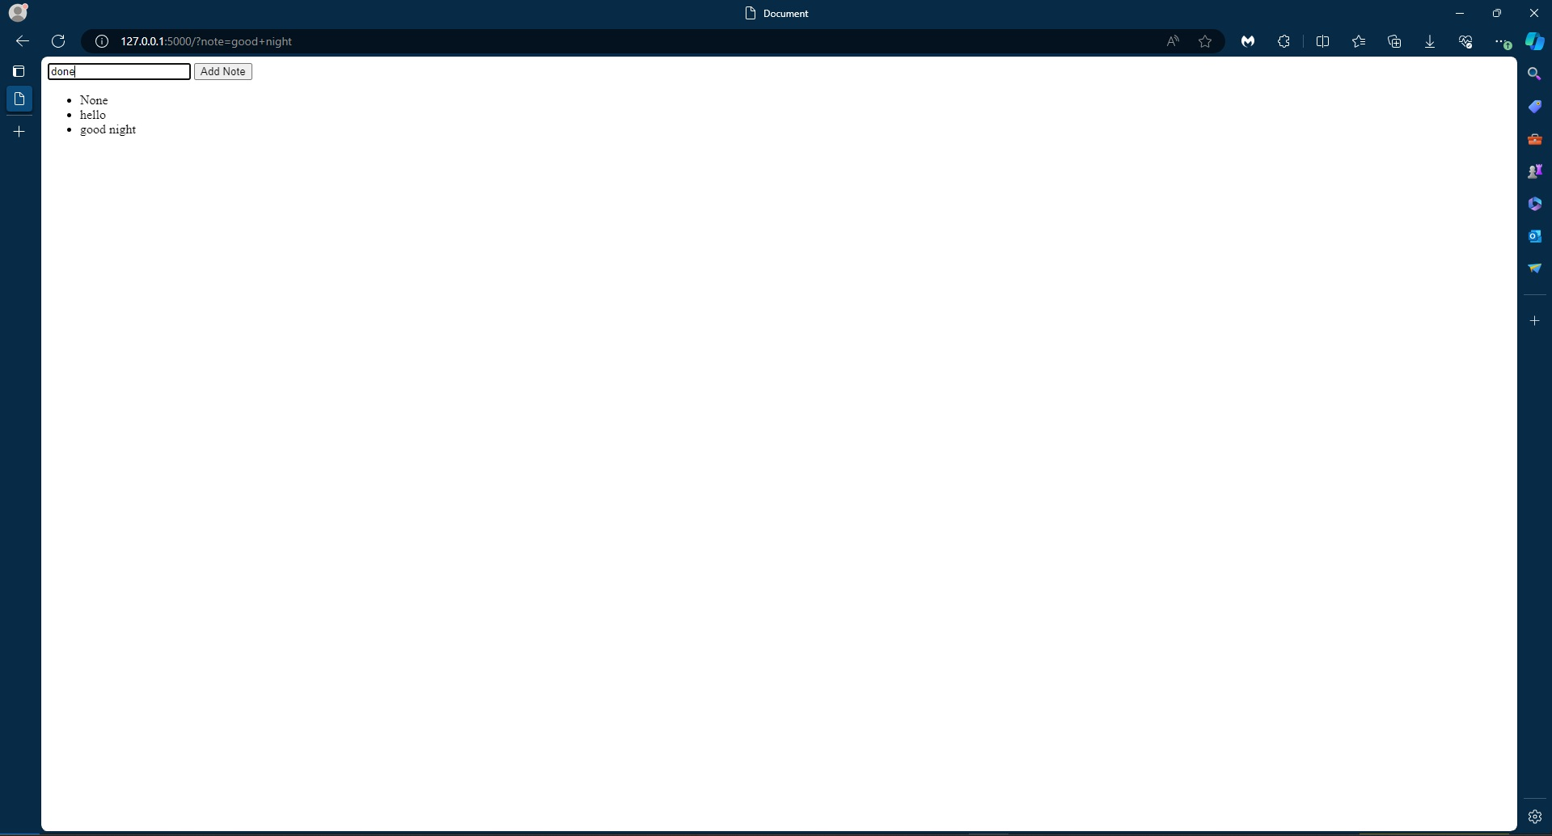
Adding
Notes !!

Slide 10
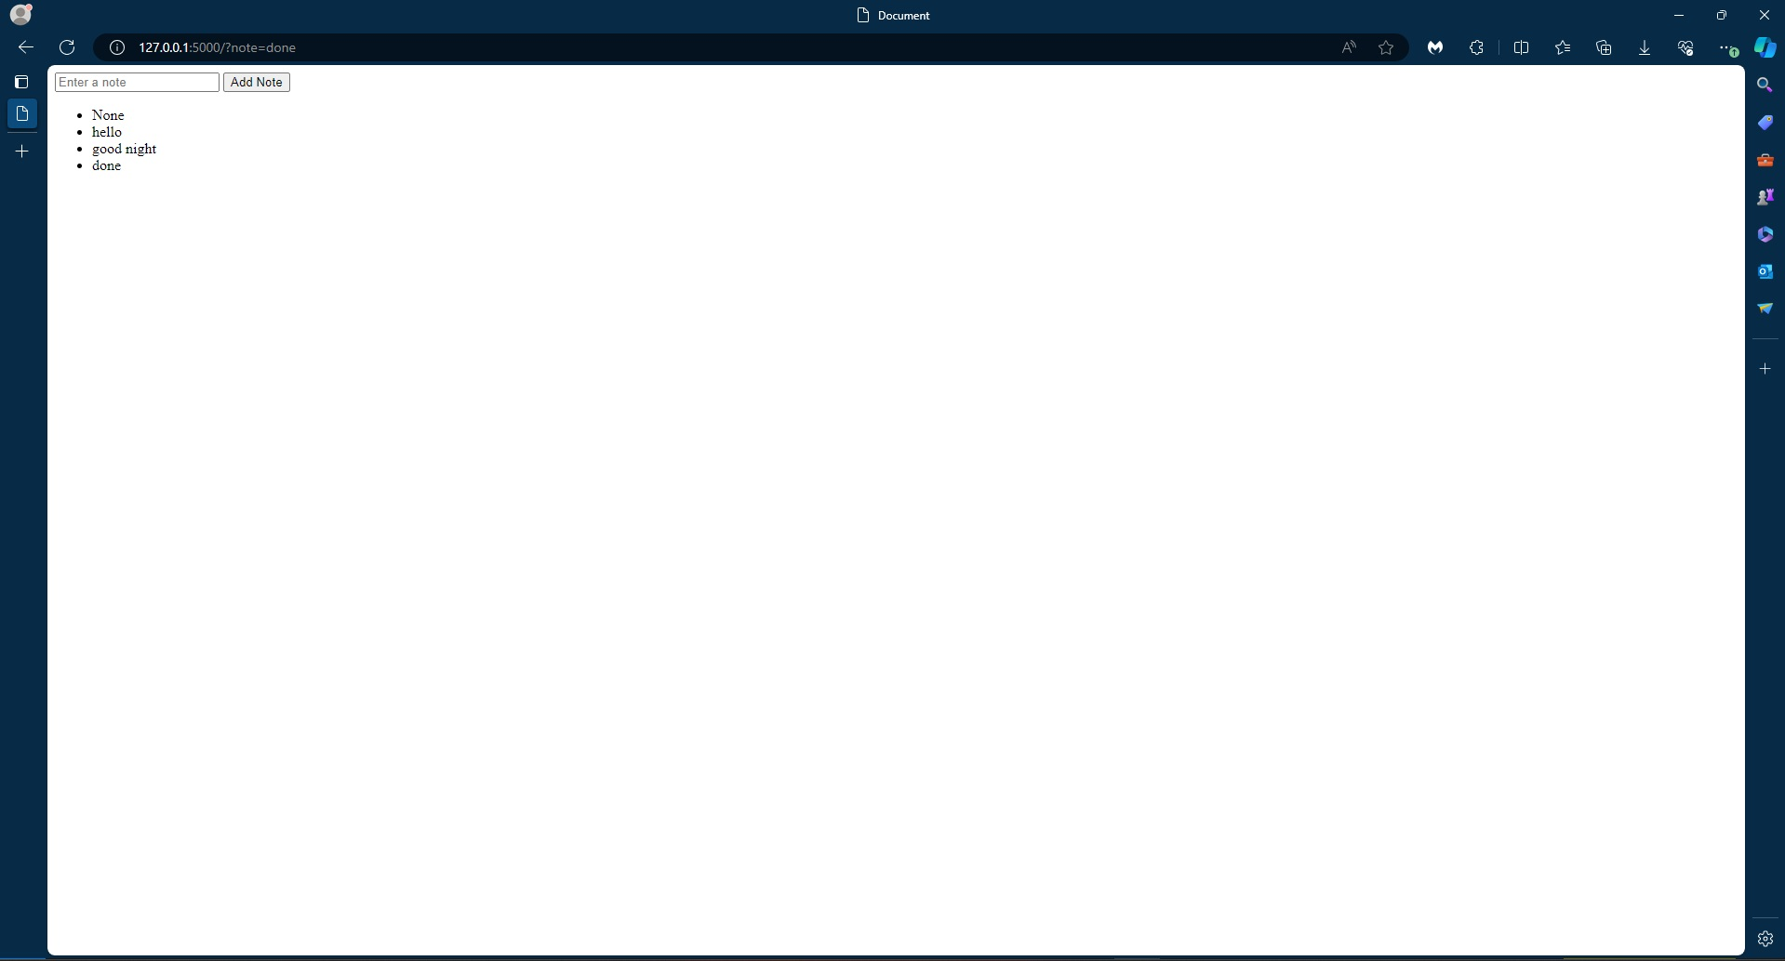
After adding notes !!

Slide 11
Future Improvements
Editing and Deleting Notes: Enhance the app by implementing functionality that enables users to edit or delete existing notes, offering greater flexibility and control over their note-taking experience.
User Authentication: Elevate the security and personalized experience of the app by integrating user authentication features. This enhancement will allow multiple users to manage their own sets of notes securely.
Customization Options: Enrich the user experience by providing customizable options. Users can tailor the appearance and organization of their notes according to their preferences, fostering a more personalized and user-centric note-taking environment.

Slide 12

THANK YOU

